Slide 1
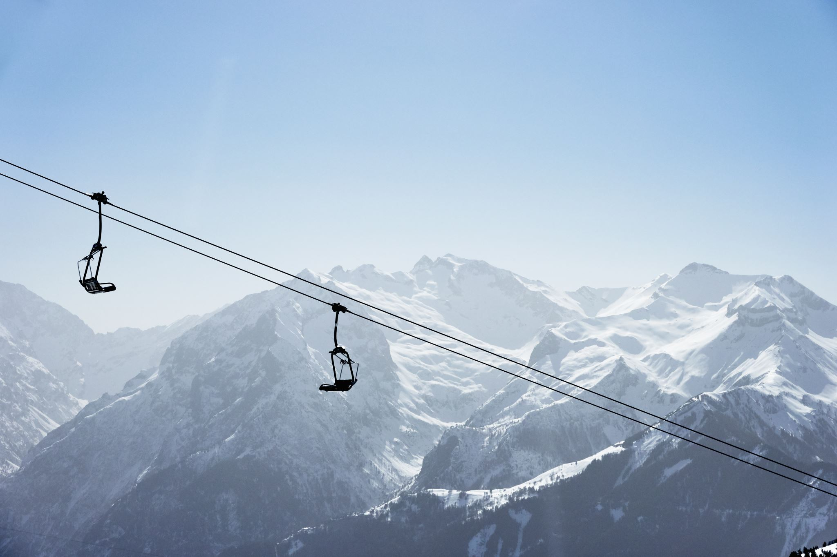
Big Mountain Resort
Effective pricing strategy for profit generation

Slide 2
Problem Statement
Due to the recent purchase of an additional chair, this has raised operating cost by $1,540,000.
The resort pricing strategy has been to charge above the average ticket price among other resorts in the market segment. This pushes away investors.
The resort is looking to select a better value for their ticket price and other avenues to increase profit by 20% to buffer operating cost.
The resort is also open to changes that will cut costs without reducing their ticket price or will support an even higher ticket price.

Slide 3
Recommendation and Key Findings
Given the range of amenities that big mountain offers and its standout value, it has support to increase its ticket price slightly
Analysis carried out suggest an increase of $1.99 which total up to 3,474,638 annually.
This increase is due to the installment new chair lift, increasing the vertical drop by 150ft and adding an additional ski run.
Revenue generated after these installments will buffer the operating cost of the new chairlift and bring in net profit for the resort.

Slide 4
Modeling Results and analysis
Linear regression model was built to identify relationship between the features and resort ticket prices.
Features found to greatly affect ticket price are vertical drop, fast quads, snow making ac and total chairs
Random forest model was implemented. It handles relationship and interactions between features better than the linear regression model.
The random forest regression model was chosen because of lower cross validation and less variability

Slide 5
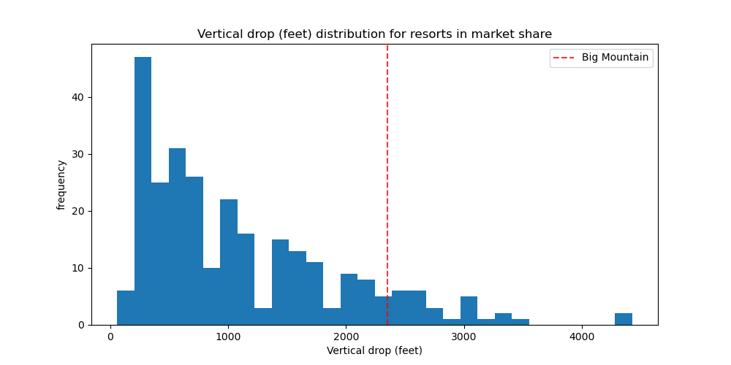
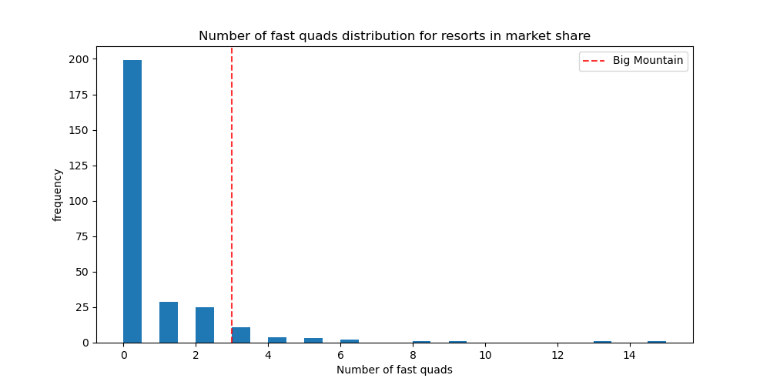
Modeling Results AND ANALYSIS
Big mountain resort 3 fast quads which puts the resort on the top when compared to other resorts.
The resort also have more than average vertical drop when compared to other resorts. This should be incresed

Slide 6
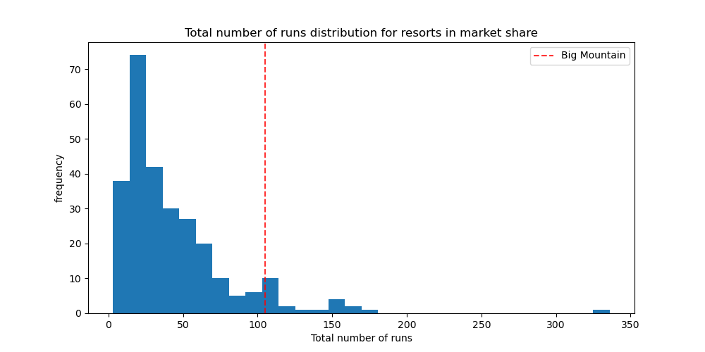
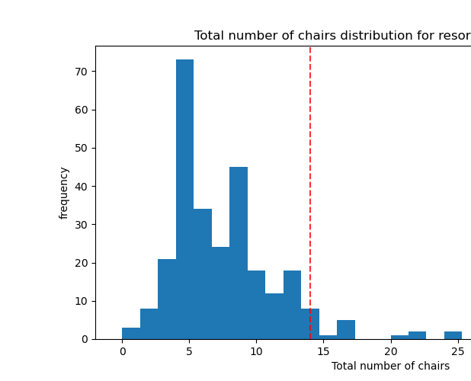
Modeling results and Analysis
Big Mountain compares well to other resorts when it comes to runs. This can also be increased.
With the newly purchased chair, Big mountains stands to be among the resorts with the highest number of chairs.

Slide 7
Modeling Results and Analysis
From the modeling results, it can be deduced that big mountain have a strong support to increase their ticket price by $1.99
This increase can be attributed to installment of the new chairlift, increasing the number of runs and also increasing the vertical drop by 150ft
This increase by $1.99 per ticket will bring in net annual profit of $3,474,638.
This profit will also buffer the operational cost of installing the new chairlift.

Slide 8
conclusion
Big Mountain resort has strong grounds to increase ticket price based on the amenities it provides when compared to other resorts.
The installment of the new chairlift, increase in both vertical drop and runs will justify this increase.
Profit gained from this increase can be used to buffer operational cost for the resort.
Future scope will be to have the complete data in terms of operational costs that includes maintenance, staff payroll and miscellaneous cost. This will aid in getting a more accurate and effective analysis.

